Slide 1
Bank Loan Case Study
By Nayan Jain

Slide 2
Project Description
The Bank Loan Case Study serves as a platform to enhance understanding of risk analytics within the banking and financial services sector.
The objective is to thoroughly explore the field of exploratory data analysis (EDA) and gain comprehensive knowledge in this area.
The study identifies patterns that indicate clients' difficulties in paying installments.
The primary objective is to determine the driving factors behind loan defaults, which serve as strong indicators of default.

Slide 3
A) Overall Approach of the analysis
Address
Address missing data by employing effective strategies for identification and handling.
Analyze
Analyze outliers within the dataset to gain insights and assess their impact.
Conduct
Conduct univariate, segmented univariate, and bivariate analyses to explore various aspects of the data.
Identify
Identify correlations between clients facing payment difficulties and other cases for comprehensive understanding.
Utilize
Utilize visualizations to succinctly summarize crucial findings and highlight key insights.
Tech - Stack Used
MS Excel

Slide 4
B) Missing Values
Initially, I utilized the COUNTA function to determine the row count for each column.
Next, I calculated the percentage of null values in each column using the formula: (1 - Total row count for each column / Total row count).
Subsequently, I eliminated columns with a null value percentage exceeding 40%.
I then employed a filter to remove blank cells from the dataset.
To focus on pertinent insights, I retained only the relevant columns.
Lastly, I converted the time duration from days to years for improved comprehension.

Slide 5
C) Outliers
Amount of Income
Within the XY plotter, an observation can be made for the target variable 0, the applicant range spans from 10Lacs to 45Lacs were outliers.
Regarding the target variable 1, a single applicant stands out with an approximate value of 30 Lacs.
In contrast, the majority of applicants lie below the threshold of 5 Lacs.

Slide 6
2) Amount of Credit
Within the XY plotter, an observation can be made for the target variable 0, where the credit range spans from 20Lacs to 41Lacs were outliers.
Regarding the target variable 1, some applicant stands out with an approximate value of 20 to 28 Lacs.
In contrast, the majority of applicants lie below the threshold of 15 Lacs.

Slide 7
3) Amount of Annuity
Within the XY plotter, an observation can be made for the target variable 0, where the credit range spans from 10 Lacs to 26 Lacs were outliers.
Regarding the target variable 1, some applicant stands out with an approximate value of 10 to 12 Lacs.
In contrast, the majority of applicants lie below the threshold of 6.5 Lacs.

Slide 8

D) Data Imbalance
This phenomenon arises when data exhibits an unequal distribution pattern.
To analyze and visualize the data imbalance, I utilized pivot tables.
1) Contract Type

Slide 9
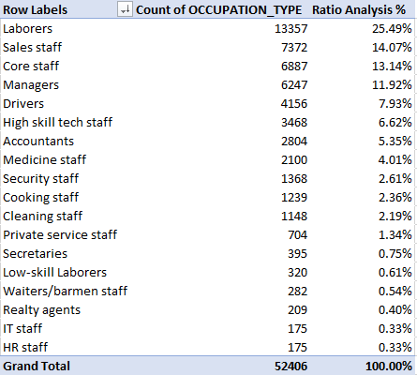
2) Occupation Type

Slide 10
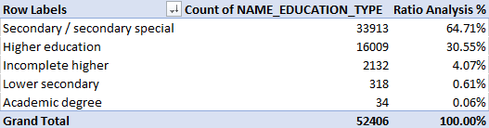
3) Education Type

Slide 11
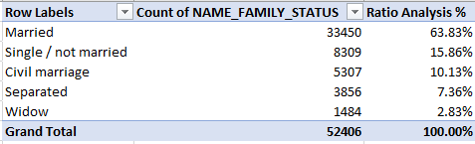
4) Family Status

Slide 12
E) Univariate analysis
Univariate analysis involves examining data that consists of a single variable, focusing on its characteristics and patterns without delving into causal relationships.
The primary objective of univariate analysis is to describe the data and identify existing patterns.
Here we can see majority of the applicants got loan approval of credit range 9 lacs and above.

Slide 13
Segmented Univariate Analysis
Segmented univariate analysis involves examining patterns and characteristics of a single variable within different subgroups or segments of the data.
The majority of applicants have an income ranging from 200k to 225k.

Slide 14
Bivariate Analysis
Bivariate analysis is the examination of the relationship between two variables to identify patterns, correlations, or associations between them.
A noticeable trend is observed where higher income is correlated with an increase in the amount of credit.

Slide 15
F) Correlation among applicants facing payment difficulties
CNT_CHILDREN | 1.0000 | 0.0274 | 0.0031 | -0.0244 | -0.3370 | -0.2452 | 0.0288 | 0.0228
AMT_INCOME_TOTAL | 0.0274 | 1.0000 | 0.3428 | 0.1679 | -0.0626 | -0.1404 | -0.0229 | -0.1866
AMT_CREDIT | 0.0031 | 0.3428 | 1.0000 | 0.1006 | 0.0474 | -0.0701 | 0.0015 | -0.1033
REGION_POPULATION_RELATIVE | -0.0244 | 0.1679 | 0.1006 | 1.0000 | 0.0252 | -0.0072 | 0.0011 | -0.5390
BIRTH(YRS) | -0.3370 | -0.0626 | 0.0474 | 0.0252 | 1.0000 | 0.6261 | 0.2713 | -0.0023
EMPLOYED (YRS) | -0.2452 | -0.1404 | -0.0701 | -0.0072 | 0.6261 | 1.0000 | 0.2767 | 0.0383
ID_PUBLISH (YRS) | 0.0288 | -0.0229 | 0.0015 | 0.0011 | 0.2713 | 0.2767 | 1.0000 | 0.0090
REGION_RATING_CLIENT | 0.0228 | -0.1866 | -0.1033 | -0.5390 | -0.0023 | 0.0383 | 0.0090 | 1.0000
 | CNT_CHILDREN | AMT_INCOME_TOTAL | AMT_CREDIT | REGION_POPULATION_RELATIVE | BIRTH(YRS) | EMPLOYED (YRS) | ID_PUBLISH (YRS) | REGION_RATING_CLIENT
The above heat map illustrates the correlation between variables for target 0 (applicants with payment delinquencies).
The heat map utilizes colors (Green, Red, and White) to signify the strength of correlation among the variables
Green color represents the strongest correlation, while Red color indicates the weakest correlation
The heat map provides a visual representation of how variables are related for applicants with payment delinquencies
Hence, the most pertinent correlations observed are AMT_TOTAL_INCOME to AMT_CREDIT, BIRTH to EMPLOYED and EMPLOYED to ID_PUBLISH

Slide 16
Correlation among applicants who made timely payments
CNT_CHILDREN | 1.0000 | 0.0048 | -0.0017 | -0.0320 | -0.2591 | -0.1929 | 0.0323 | 0.0407
AMT_INCOME_TOTAL | 0.0048 | 1.0000 | 0.0381 | 0.0091 | -0.0031 | -0.0150 | 0.0042 | -0.0215
AMT_CREDIT | -0.0017 | 0.0381 | 1.0000 | 0.0692 | 0.1353 | 0.0019 | 0.0523 | -0.0592
REGION_POPULATION_RELATIVE | -0.0320 | 0.0091 | 0.0692 | 1.0000 | 0.0482 | 0.0155 | 0.0155 | -0.4432
BIRTH(YRS) | -0.2591 | -0.0031 | 0.1353 | 0.0482 | 1.0000 | 0.5822 | 0.2529 | -0.0339
EMPLOYED (YRS) | -0.1929 | -0.0150 | 0.0019 | 0.0155 | 0.5822 | 1.0000 | 0.2291 | 0.0035
ID_PUBLISH (YRS) | 0.0323 | 0.0042 | 0.0523 | 0.0155 | 0.2529 | 0.2291 | 1.0000 | -0.0014
REGION_RATING_CLIENT | 0.0407 | -0.0215 | -0.0592 | -0.4432 | -0.0339 | 0.0035 | -0.0014 | 1.0000
 | CNT_CHILDREN | AMT_INCOME_TOTAL | AMT_CREDIT | REGION_POPULATION_RELATIVE | BIRTH(YRS) | EMPLOYED (YRS) | ID_PUBLISH (YRS) | REGION_RATING_CLIENT
The above heat map illustrates the correlation between variables for target 1 (applicants with payment made on time).
The heat map utilizes colors (Green, Red, and White) to signify the strength of correlation among the variables
Green color represents the strongest correlation, while Red color indicates the weakest correlation
The heat map provides a visual representation of how variables are related for applicants who made payments on time
Hence, the most pertinent correlations observed are BIRTH to EMPLOYED, EMPLOYED to ID_PUBLISH and ID_PUBLISH to BIRTH

Slide 17
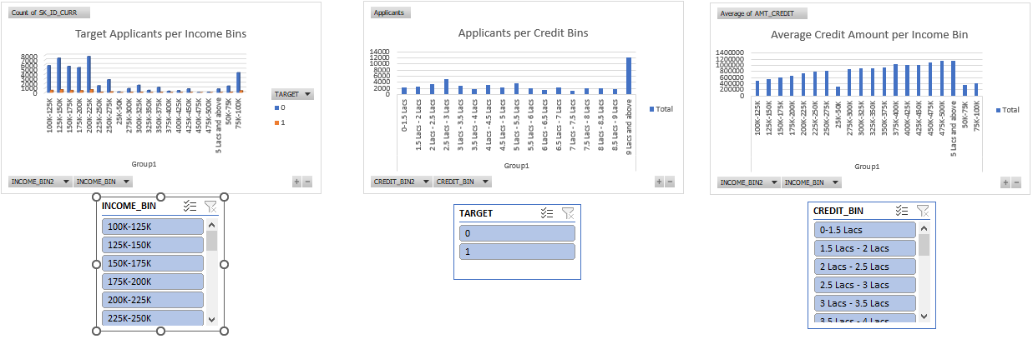
Dashboard

Slide 18

Result
A significant majority of applicants received loan approvals for credit amounts of 9 lacs or higher.
Higher-income applicants were granted larger credit amounts.
The majority of applicants (both 0 and 1) have an income ranging from 0 lacs to 2.5 lacs
Please access the provided link to obtain the Excel file and explore in-depth analysis
Bank Loan Case Study.xlsx

